Slide 1
DrDiff：Decoupling Code Change into Multiple Design Insights
崔笛
cuidi@stu.xjtu.edu.cn
智能网络与网络安全教育部重点实验室
陕西省天地网技术重点实验室
2018年11月21日

Slide 2
Content
1、Introduction
2、Related Work
3、Methodology
4、Evaluation
5、Conclusion

Slide 3
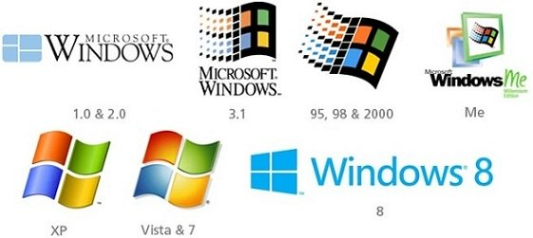
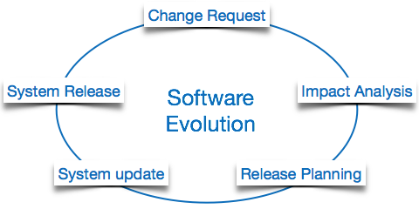
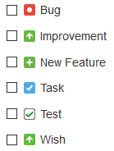
Introduction
Almost every software evolves to meet the increasing requirement of users .
Software evolution includes requirement evolution, environment evolution, source code evolution, and etc.
Source code change dominates the activities in software evolution through software system’s lifecycle.
In most cases, source code changes for adding new features, fixing bugs, refactoring, and etc.
Notes:
Evolution of requirement
Evolution of execution environment
Software evolution dominate the activities in a software system’s lifecycle.

Slide 4
Introduction
However, analyzing and understanding source code changes is not easy!
Using Spring-Framework (1.3M+) as an example:
Fast growth (4.6 commits per day)
Large Amount ( Average 100+ Lines of code per commit)
Complex Relations (Average 5 Files per commit)

Slide 5
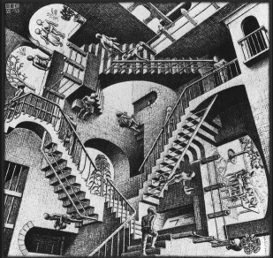

Introduction
A natural question arises do developer really understand what they changed?
In most cases, actually not!
Accidental Complexity (Fred Book, 1990)
Technical Debt (Cunningham, 1992)
Architectural Erosion and Drift (Nenad Medvidovic, 2009)
Modularity Violation (Yuanfang Cai, 2010)
…..
Now, most of developers are still not aware of, especially, the architectural impact of their change [1].
[1] Paixao M, Krinke J, Han D G, et al. Are developers aware of the architectural impact of their changes?[C]// Ieee/acm International Conference on Automated Software Engineering. IEEE, 2017:95-105.

Slide 6
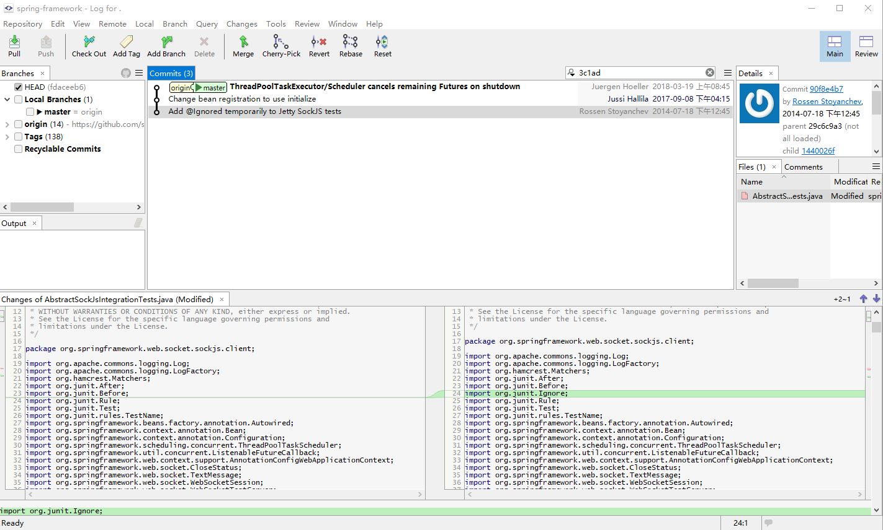
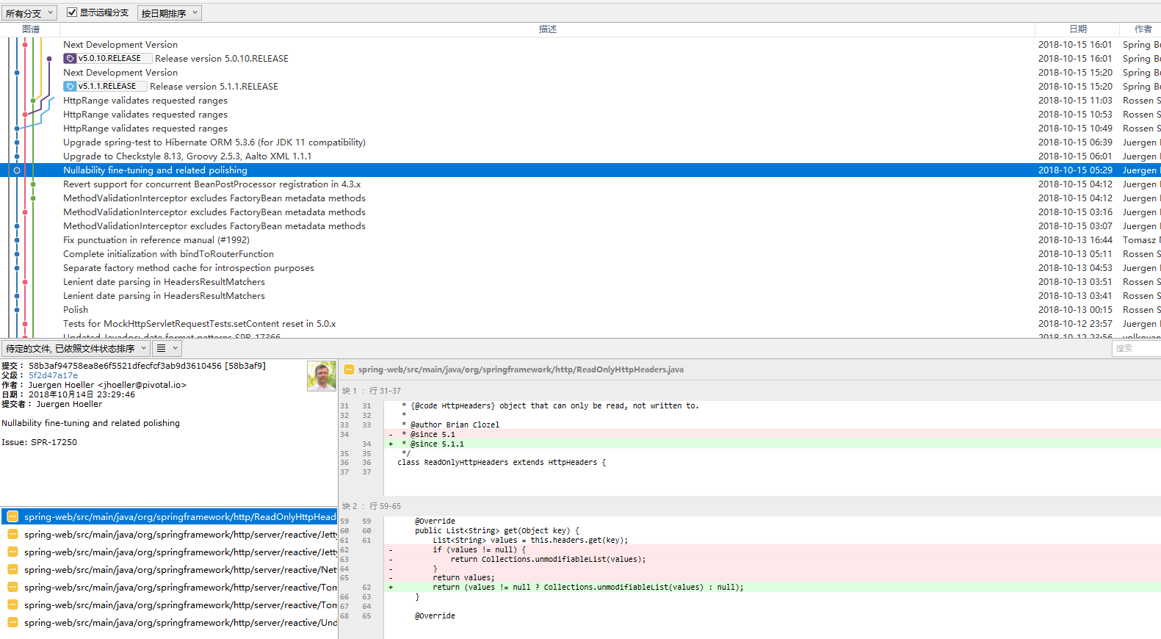
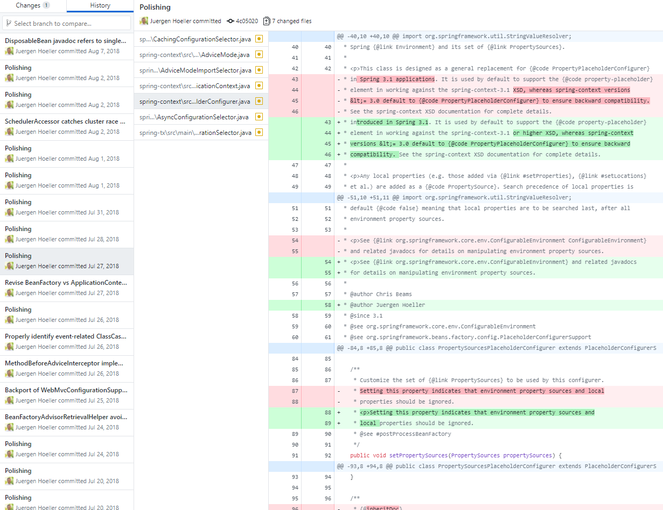
Introduction
This may probably caused by the way developers understand code changes.
SmartGit
SourceTree
Two primary reasons:
Local not systematic
Historical not multiple views
Github Desktop

Slide 7
Introduction
We need a non-local and systematic view to understand code changes.
Thus, in this paper, we proposed a general method to decouple a code change into three views: structural, historical and semantic view.
Structural View (Architect Insight) (methods declarations and global variables)
Structural view presents the organization of change sets over the method-level, depicting the skeleton of software project.
Semantic View (Practitioner Insight) (method parameters and local variables)
Semantic view presents the organization of change sets within the
method-level, depicting the detail implementation.
Historical View (Tester Insight / Code Reviewer Insight)
Historical view focuses the code difference compared with the
previous version

Slide 8
Content
1、Introduction
2、Related Work
3、Methodology
4、Evaluation
5、Conclusion

Slide 9
Related Work
Classical Code Differencing / Code Change Techniques (fine-grained)
Detecting code differences is the opposite to code clone. The object is the program and its previous version. Hence, the method is also similar.
Text-based
A file comparison program (EW Myers et.al, 1985)
Tracking source locations (Reiss et.al, ICSE 08)
Tree-based
Change distilling: Tree differencing for fine-grained source code change extraction (Fluri et.al TSE 07)
GumTree: Fine-grained and Accurate Source Code Differencing (Falleri et.al ASE 14)
ClDiff: Generating concise linked code differences (Xin Peng et.al ASE 18)
Graph-based
A Differencing Algorithm for Object-Oriented Programs (Taweeup et.al ASE 04)
UMLDiff: An Algorithm for Object- oriented Design Differencing (Xing et.al ASE 05)

Slide 10
Related Work
Code Change Summarization (coarse-grained)(Machine-learning based)
Changescribe: A tool for automatically generating commit messages (Cortes-Coy et.al, SCAM 2014)
Automatically generating commit messages from diffs using neural machine translation (Jiang et.al, ASE 17)
Systematic Code Change (code clone in code change)
Systematic code change (i.e. similar, related code changes) can be caused by crosscutting concerns, API evolution, bug fixing and refactoring.
Automatic Inference of Structural Changes for Matching Across Program Versions (Kim et.al, ICSE 07)
Interactive Code Review for Systematic Changes (Kim et.al, ICSE 15)
Code Change Decomposition (filtering irrelevant/unrelated code changes)
The impact of tangled code changes (Zeller et.al, MSR 13)
Untangling fine-grained code changes (Dias et.al, SANER 15)

Slide 11
Content
1、Introduction
2、Related Work
3、Methodology
4、Evaluation
5、Conclusion

Slide 12
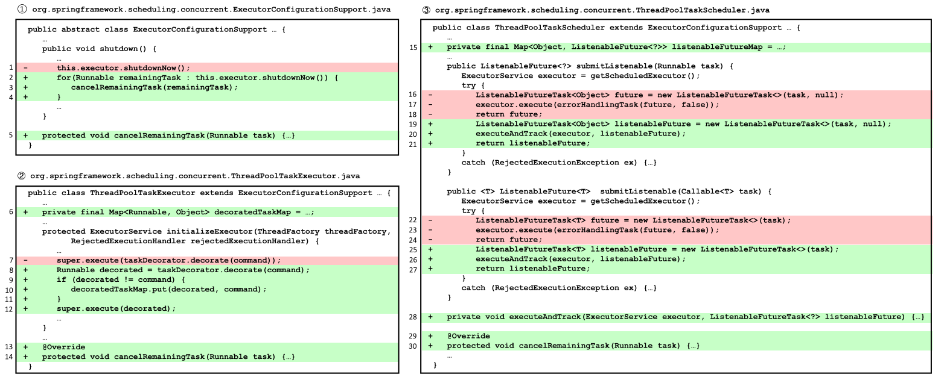
A Running Example
A running example of Code Change from Commit 3c1adf7: 8 changed files with 478 additions and 96 deletions

Slide 13
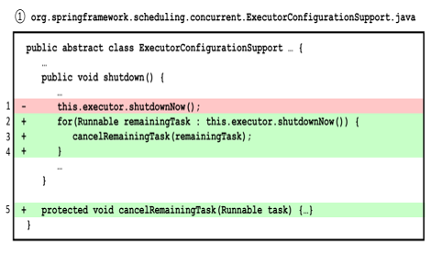
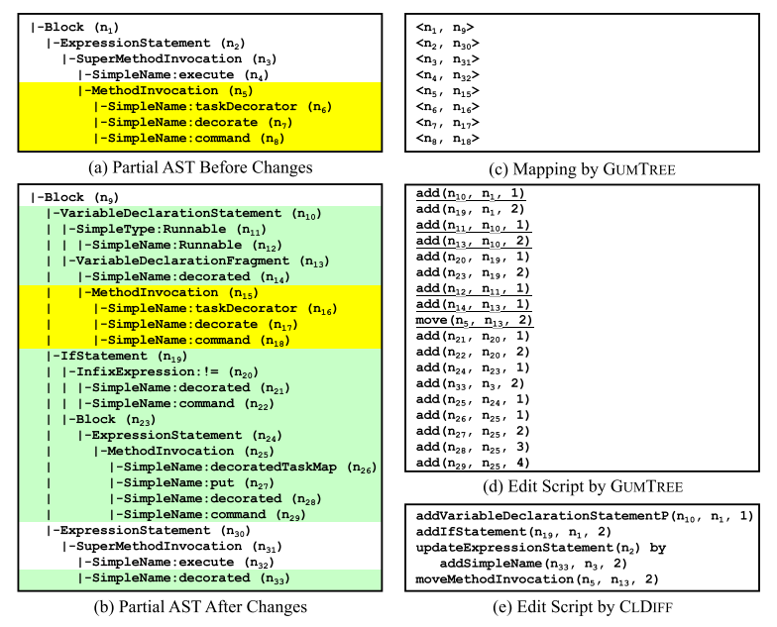
State-of-the-art
Tree-based code differencing techniques
Preliminaries:
AST: abstract syntactic tree, a rooted, labeled, ordered tree.
AST Node Type: declaration, statements, and more than 22 subtypes.
AST Differencing: four kinds of edit actions including update, add, delete, move. Such action sequences are called Edit Script.
Concise Differencing: encapsulate edit scripts

Slide 14
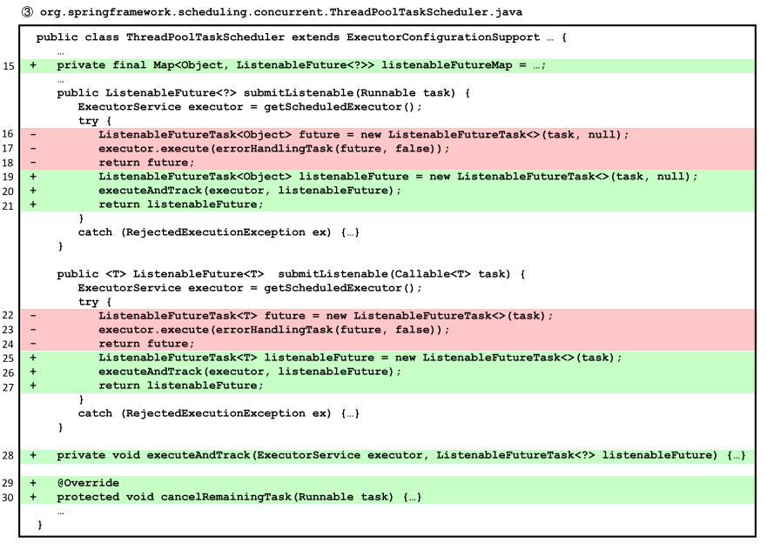
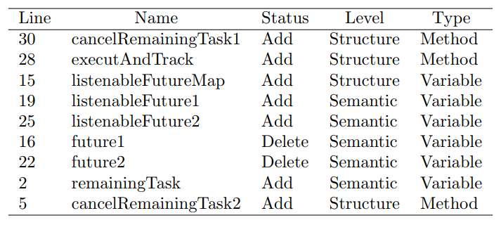
Our method
Step1: Extracting Micro Design Rules

Slide 15
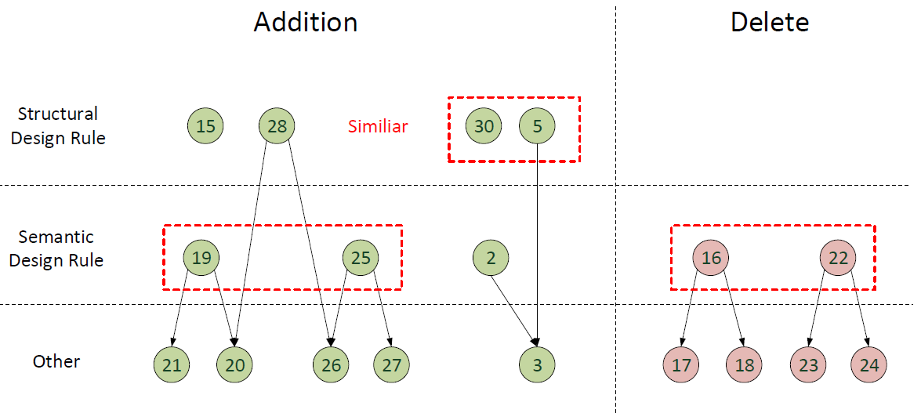
Our method
Step2: Organizing Dominate Relation

Slide 16
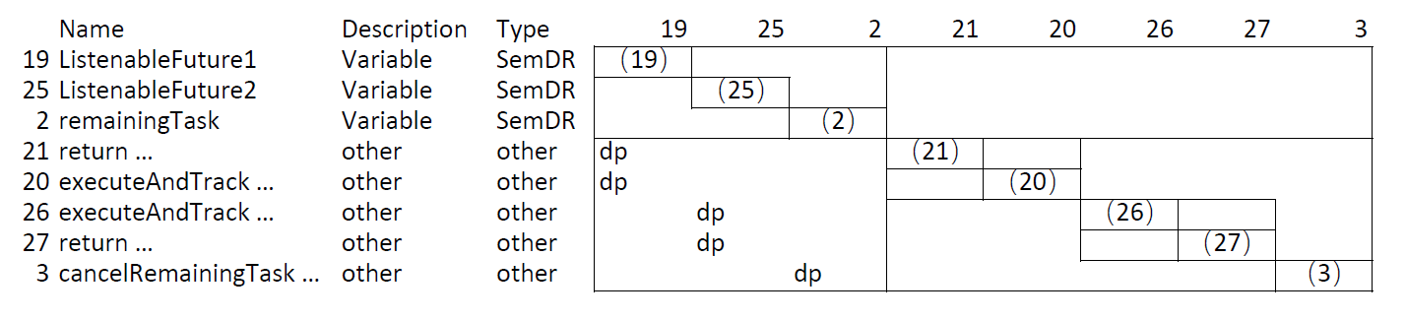
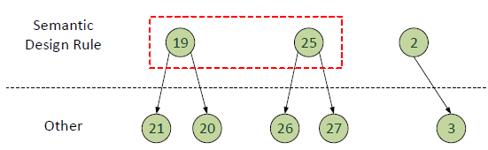
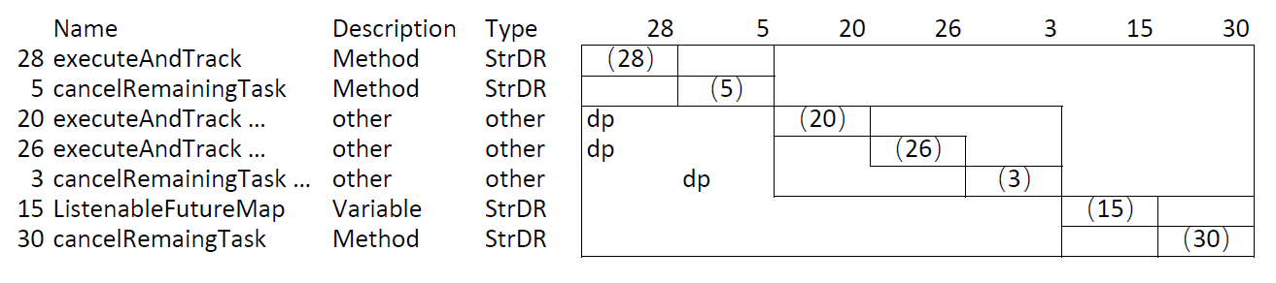
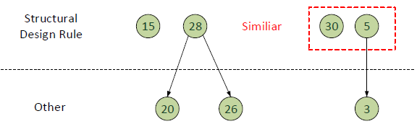
Our method
Step3: Generating Structural and Semantic Insight using DRH
Semantic Insight
Semantic Design Rule
Structural Insight
Structural Design Rule
Structural Design Rule
To be improved

Slide 17
DrDiff Infrastructure (Implementation)
System Requirement:
The combination of these three insight
The genealogy of three insights
To be improved
Fundamental Tool Support:
Spoon
JGit
We are now starting from some influential code difference toolkits: ChangeDistiller, GumTree and ClDiff.

Slide 18
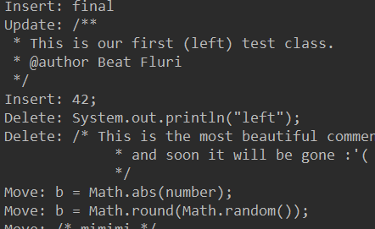
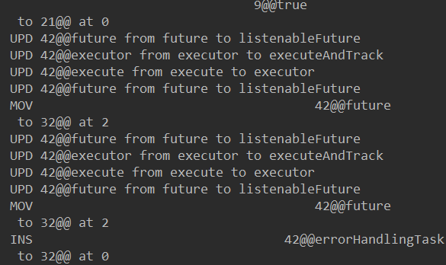
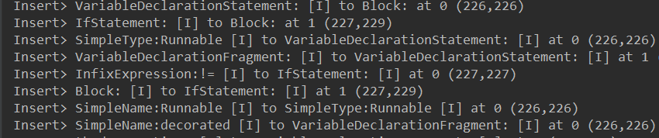
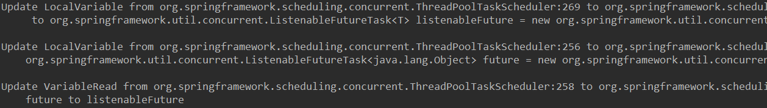
A Comparison of Multiple Change Tool
ChangeDistiller
GumTree
CLDiff
GumTree-Spoon

Slide 19
DrDiff Design
5 Layer
Requirement Code
Structural Layer (Skeleton)
Semantic Layer (local variable and method)
Dominated Code
Other (irrelevant code)
3 types of relations:
In-out relation
Clone relation
Dominate relation
We are now constructing this structural and hierarchical view.

Slide 20
Current Progress
尚未完成DrDiff，现有的版本已经完成计划的60%，现有的版本可以：
初步可以自动检出修改文件的前后版本并做Text Diff Analysis（GitDiff：已完成100%）
利用Spoon进行细粒度的Diff分析，得到差异的AST节点（SpoonDiff：已完成100%）
分类Changed AST节点为5类，提取Change中的三种依赖关系，包括in-out，clone和subordinate（RelationDiff：已完成30%，下周预计完成基础功能）
下周工作计划：
完成DrDiff工具的第一版
Raw Diff
Git Diff
Spoon Diff
Relation Diff
DRDiff 设计

Slide 21
Content
1、Introduction
2、Related Work
3、Methodology
4、Evaluation
5、Conclusion

Slide 22
Evaluation
Target: How can DrDiff help developer understand three mentioned characteristics?
From the commit
RQ1: How many design rules contained in one commit?
RQ2: How many design rules contained in multiple commit? (per day/month/year)
(using genealogy)
From the design rule
RQ3: How many commits can be affected by one design rule?
RQ4: How long does one design rule have effect on software?

Slide 23
Content
1、Introduction
2、Related Work
3、Methodology
4、Evaluation
5、Conclusion

Slide 24
Conclusion
To be continued

Slide 25
Thank you
Thanks！Q&A

